Slide 1
Output In Python
The print command

Slide 2
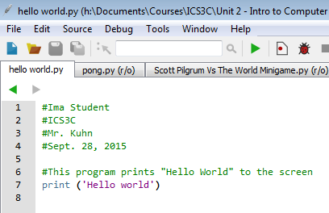
Examine Hello World
All programs start with the necessary header info
Your name
Course code
Teacher’s name
Date started
Program description
Source code follows underneath
Note: All text that begins with a ‘#’ symbol is called documentation and is ignored by Python

Slide 3
The print command
The print command is the built-in keyword to display text to the screen.
The print command can display combinations of letters, numbers, and symbols

Slide 4
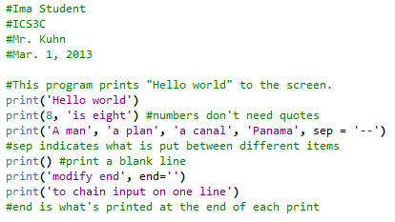

print examples 1

Slide 5
Details
print is used to print text surrounded by single quotes (‘…’) or double-quotes (“…”)
print can print numbers/math without quotes
Print multiple items (tokens) in one command with each item separated by a comma

Slide 6
Details Continued
print has two modifier flags: the sep flag and the end flag
sep is what is printed between different tokens. The default is a space
sep=‘’ means nothing is printed between tokens
end is what is printed at the end of the print statement. The default is a newline character
end=‘’ means the next print will be on the same line as the previous print

Slide 7
Details Continued
Certain characters have special meaning in Python and require special representation to be printed. Commonly used ones are:
‘\n’ for newline
‘\t’ for tab
‘\”’ for double quote
‘\’’ for single quote
‘\\’ for backslash

Slide 8
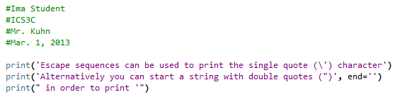

print examples 2

